Slide 1
------------------------------------------------
01.102 Energy System and Management
Unit Commitment Optimization
Wang Yiran (1000906)
Li Linfeng (1000920)
Liu Sidian (1000909)

Slide 2
----------------
Outline
01 Introduction
02 Mixed Integer Nonlinear programing
03 Result & Discussion

Slide 3
0 1
----------------
Introduction

Slide 4
----------------
Unit Commitment Problem Recap
System operator collects bid
Solves unit commitment problem
Decide the on/off status of each generator at every hour of the next day
Notes:
By 12pm of a Sunday, the system operator collects the supply curves submitted by all generators, for each hour of the next day (Monday).
The SO solves a UC problem (that seeks to minimize the total cost for the Monday 24-hour period) to decide the on/off status of each generator at every hour of Monday.

Slide 5
----------------
Data Resource
Federal Energy Regulatory Commission (FERC) Library
Summer Unit Commitment Test Problem
Take first 5, 7 and 10 generators out of total 1011 Generators
Parameters & Simplification
Weighted Average Cost instead of Nonlinear Pricing
Maximum Capacity ------ Seasonal Capacity
Minimum Capacity
Ramp Up Time; Ramp Down Time
Minimum Up & Down Time
Source from: https://www.ferc.gov/industries/electric/indus-act/market-planning/rto-commit-test.asp

Slide 6
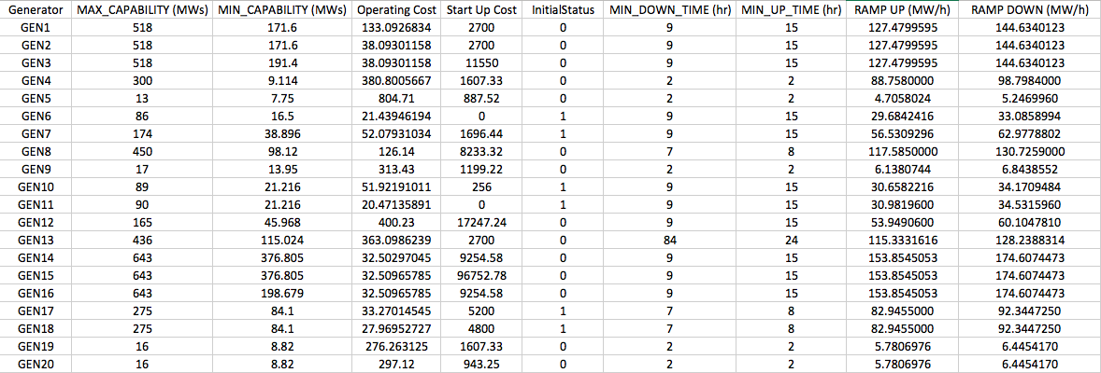
----------------
Data Sheet

Slide 7
----------------
Tools Utilized
Optimization Platform
julia (packages: JuMP, CoinOptServices)
Algorithms
Solvers Packages | NLP (Non-linear program) | MILP (Mixed Integer Program) | MINLP (Mixed Integer Nonlinear Program)
Cbc |  | ✔
Ipopt | ✔
Bonmin | ✔ | ✔ | ✔

Slide 8
02
Mixed Integer Nonlinear Programming
----------------

Slide 9
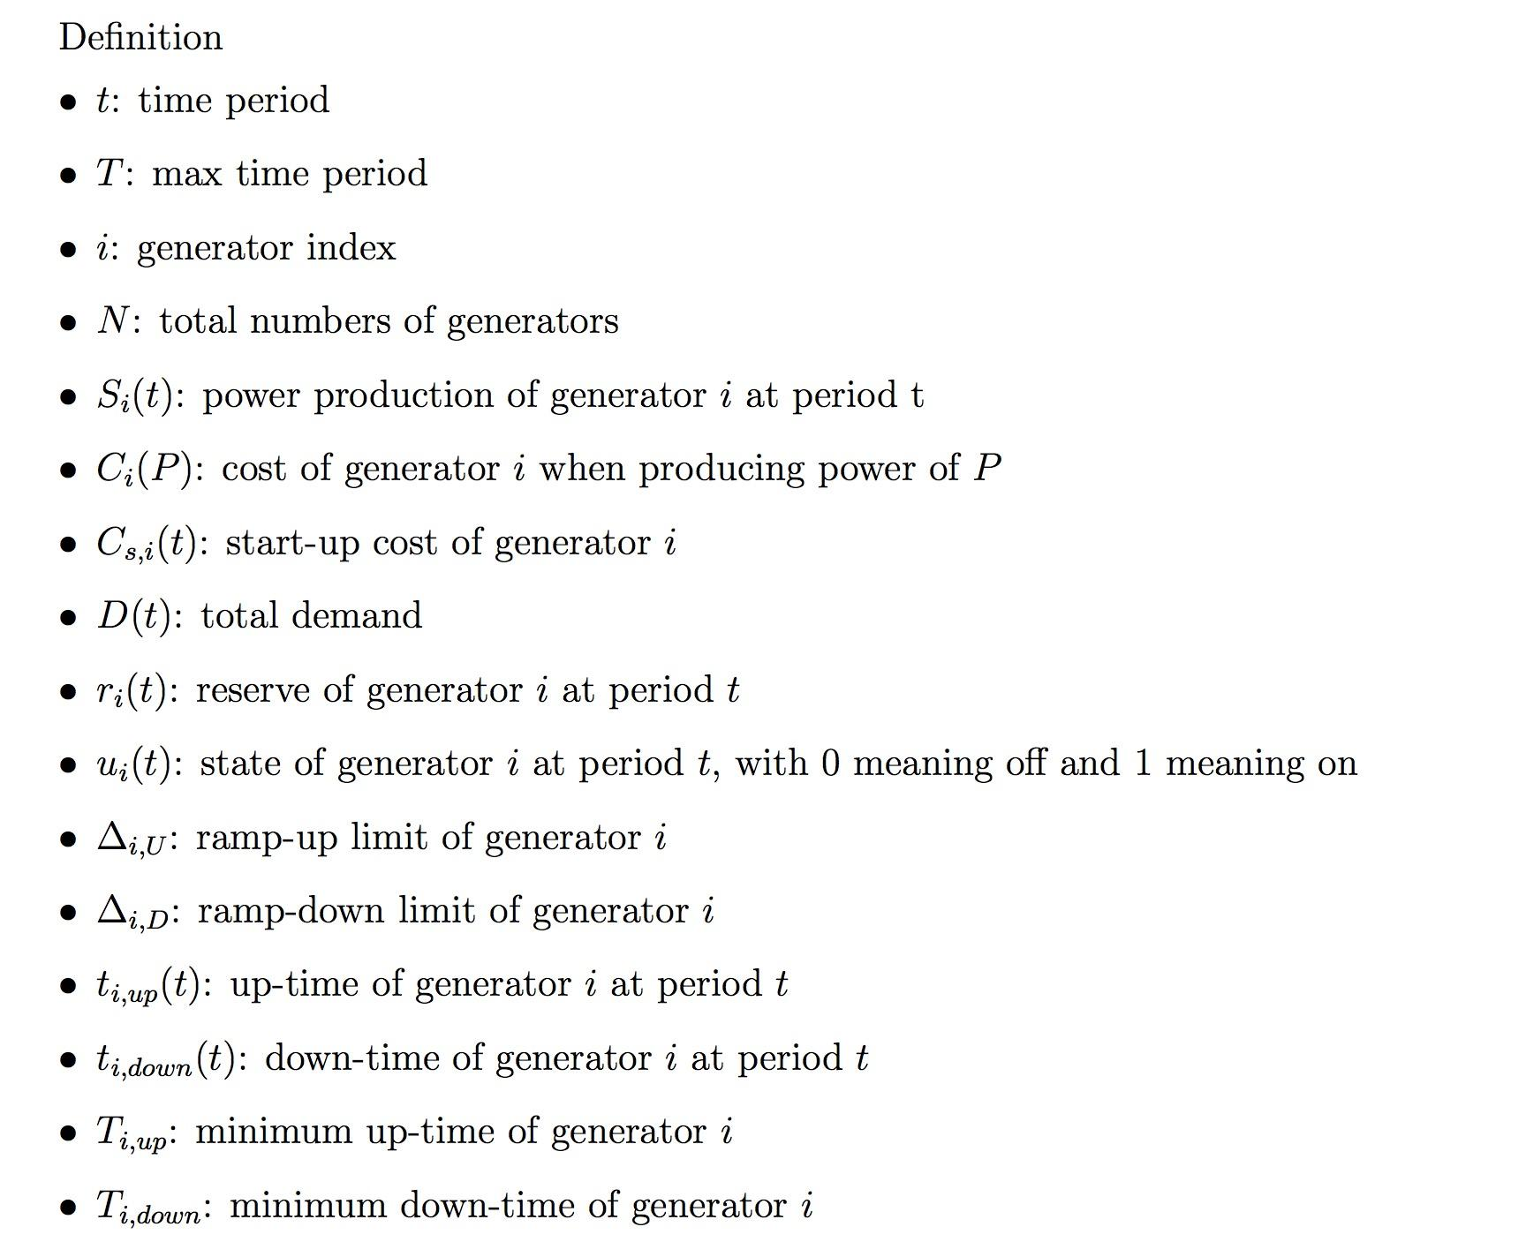
----------------
Variables & Parameters

Slide 10
----------------
Variables & Parameters

Slide 11
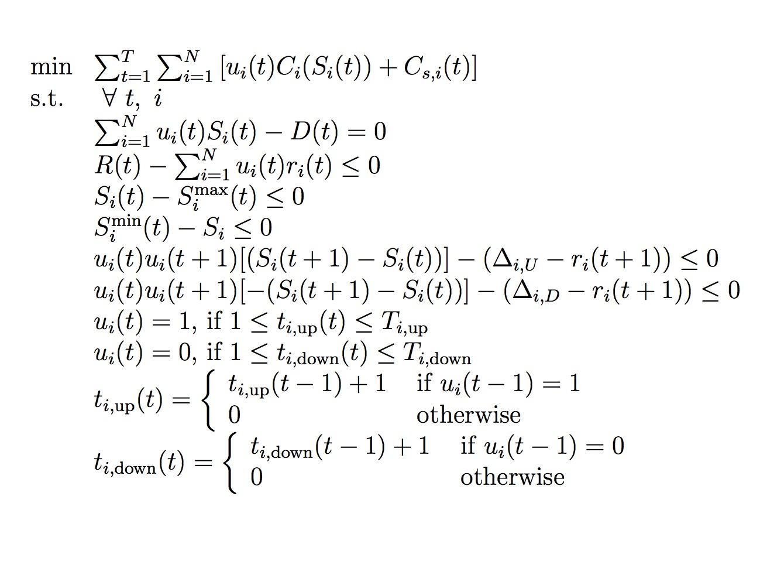
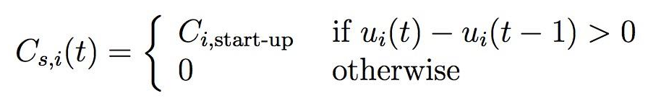
----------------
Formulation
Demand Constraint
Reserve Constraint
Capacity Constraints
Ramp Up & Down
Up & Down Time Constraints
Define Up & Down Time
Define Start Up Cost

Slide 12
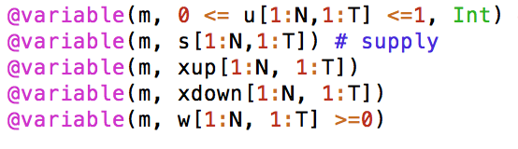
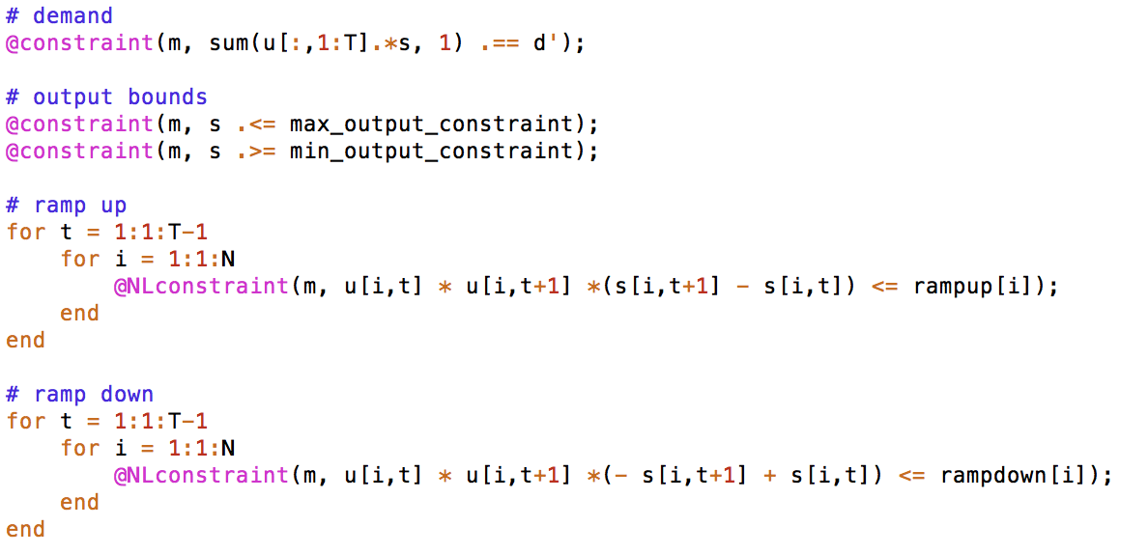
----------------
Formulation
Define variables:
Add constraints:
Define objective:

Slide 13
----------------
Re-Formulation
“if” conditions in the constraints:

Slide 14
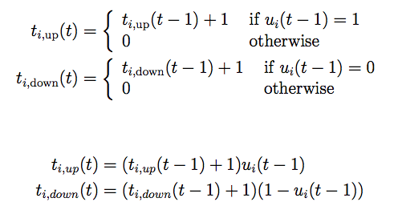
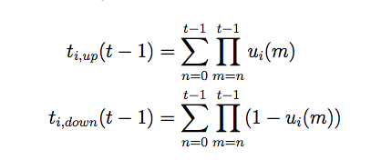
----------------
Re-Formulation
De-conditionalization (removal of if)
1.1. Up and Down Time Definitions
c.f. HW 3 Soln: Highly Non-linear

Slide 15
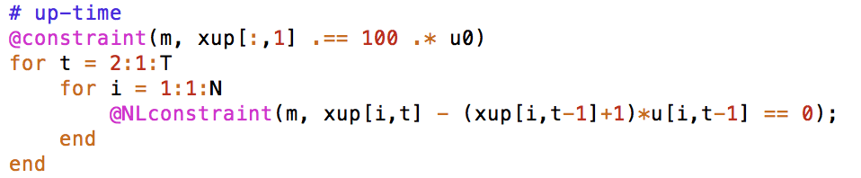
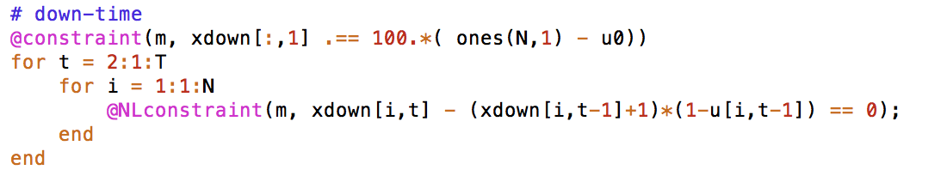
----------------
Re-Formulation
De-conditionalization (removal of if)
1.1. Up and Down Time Definitions

Slide 16
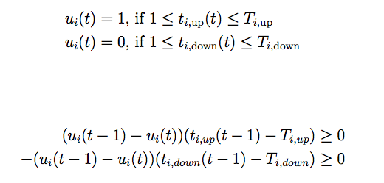
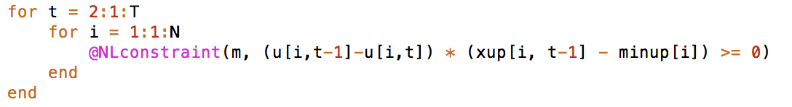
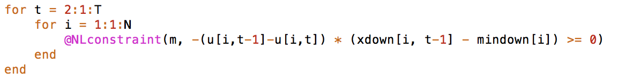
----------------
Re-Formulation
De-conditionalization (removal of if)
1.2. Up and Down Time Constraints

Slide 17

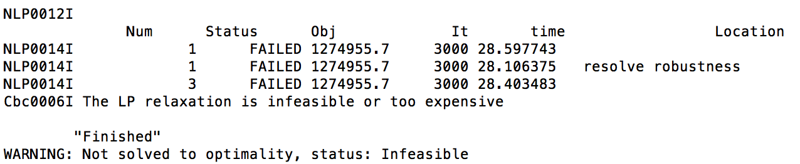

----------------
Re-Formulation
De-conditionalization (removal of if)
1.3. Start-up Cost Definition

Slide 18
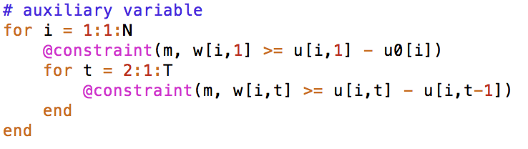
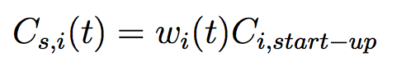

----------------
Re-Formulation
2. Linearize “Max()”
Define Auxiliary Variables wi(t)
Notes:
By forcing w to be bigger than both terms, we linearized this constraints

Slide 19
03
Results & Discussion
----------------

Slide 20
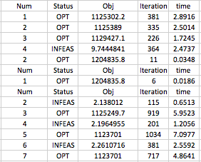
----------------
4 Generators, 24h
Solving Iteration Example
Optimal Value(Objective Fnc): 1204835.755366065
Solving Time: 294.31 seconds
Notes:
By forcing w to be bigger than both terms, we linearized this constraints

Slide 21
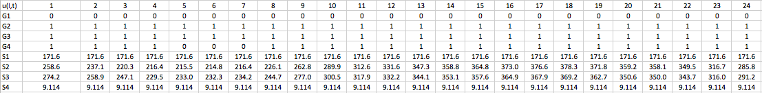
----------------
4 Generators 24h
Variables Optimal Values:

Slide 22
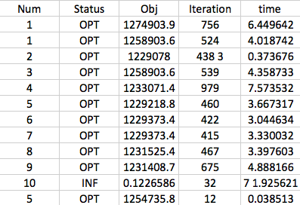
----------------
5 Generators, 24h
Solving Iteration Example
Optimal Value(Objective Fnc): 1254735.80
Solving Time: 56.58 seconds
Notes:
By forcing w to be bigger than both terms, we linearized this constraints

Slide 23
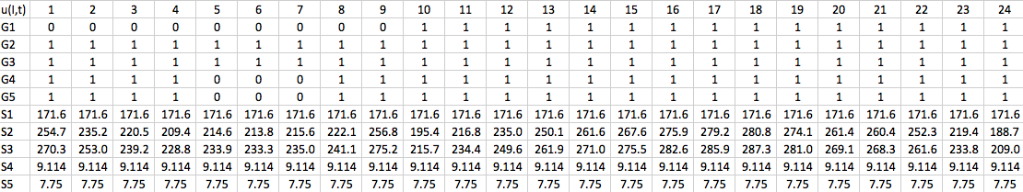
----------------
5 Generators 24h
Variables Optimal Values:

Slide 24
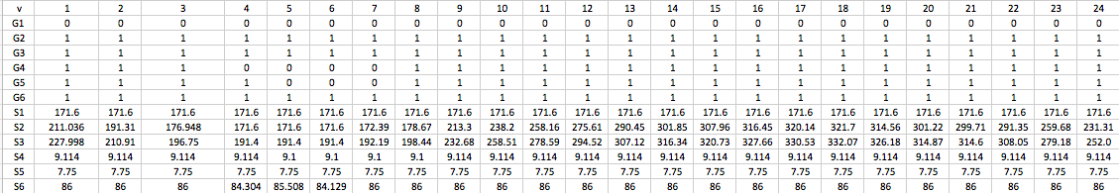
----------------
6 Generators, 24h
Optimal Value (Objective Fnc): 1316129.073121196
Solving Time: 1444.43 seconds

Slide 25
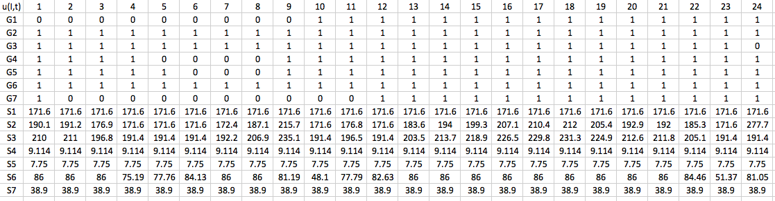
----------------
7 Generators, 24h
Optimal Value (Objective Fnc): 1259507.706079903
Solving Time: 174.6 seconds

Slide 26
----------------
8 Generators, 24h
Optimal Value (Objective Fnc): 1547002.7
Solving Time: 3752.84 seconds

Slide 27
----------------
10 Generators, 24h
“The LP relaxation is infeasible or too expensive”
Reasons?
Running time too long
Reached the constraints or variable limits of the solver
Requires stronger computational power than the platform is capable of

Slide 28
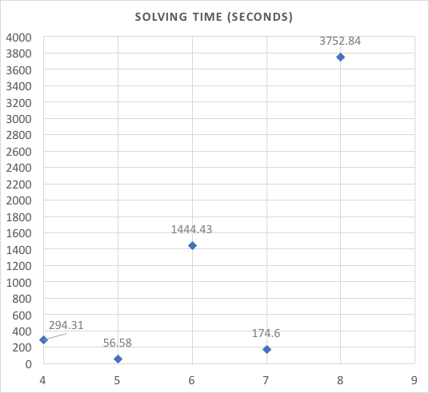
----------------
Generators V.S. Solving Time
The solving time is not simply increasing with the increasing number of generators.
Generators’ attributes such like operating costs, startup costs also played an important role for the solving time.

Slide 29
----------------
Data Sheet

Slide 30
----------------
Findings
Running time is not proportional to the scale of the problem, but is determined by the nature of the attributes involved.
More than 80% of the time, generators are on
start-up cost included, cost money to restart a generator
Demands were low for the first 12 hours and high for the second, generators’ utilization reflected this pattern

Slide 31
----------------
Conclusion
Large Scale
Number of generators N >> 10
Mixed integer solutions and Nonlinear constraints
Additional constraints on reserve, minimum start time etc.
Greedy algorithm, no exact solutions
Problems are always harder in real life

Slide 32
------------------------------------------------
Thank You !

